Slide 1
SRS Presentation
By: Team 1
Ryan Ross
Cam Kozan
Zaid Alsafi
Alex Navarre

Slide 2
Goals and Objectives
To create a webpage for companies to present easily digestible data for their employees to view and track metrics. The purpose of this is to create a friendly and competitive environment where workers will be motivated to change and develop better behaviors and practices determined by the company.

Slide 3
Software Context
We are to create a webpage where employers and employees that can view statistics about their performance. The webpage will display a dashboard that allows users to view statistics and provide a login panel. Users will see a different view depending on their account level. An employee will see data about their own performance. A manager will be able to see the statistics of the employees under them. The Admin will be able to see the statistics of the managers and their teams below them, along with seeing the overall stats of the company. The admin will be allowed to change the weight of each field to adjust the leaderboard based on the significance of the weight.

Slide 4
Major Constraints
Time
Availability of the Team and owner
Accessibility of previous project artifacts
Limited knowledge of used technology

Slide 5
User Interface
There will be three different user interface views: Administrator, Manager, & Employee
Administrator: Displays full access to Manager and Employee views
Allows the user to edit weights and costs for tools
Displays all manager and employee scores and statistics
Manager: Allows user to edit individual employee scores
Employee: Only displays individual score and leaderboard
User interface will be displayed using a webpage

Slide 6
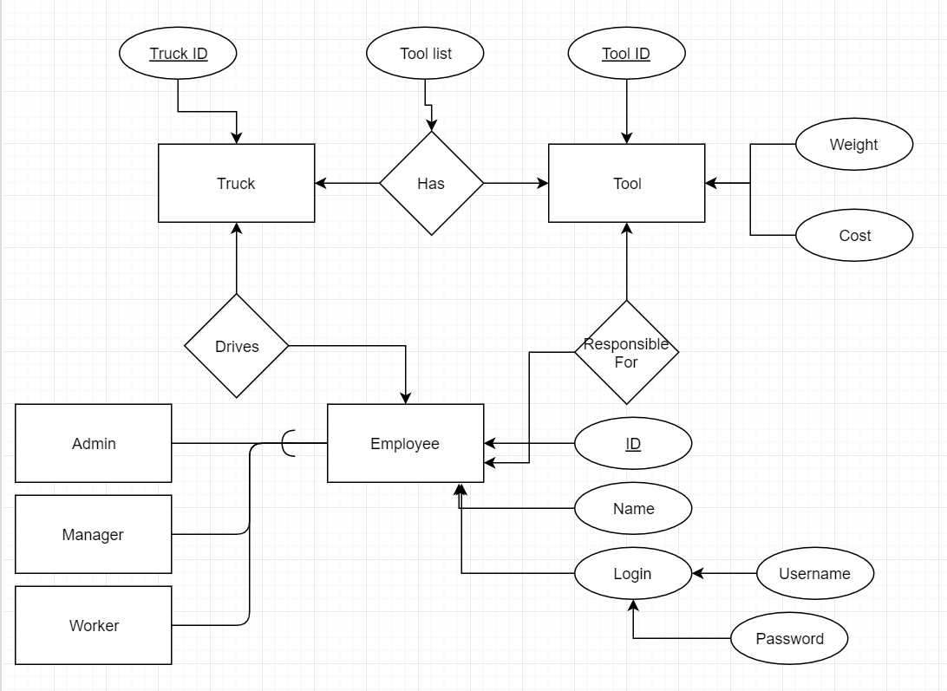
Complete Data Model

Slide 7
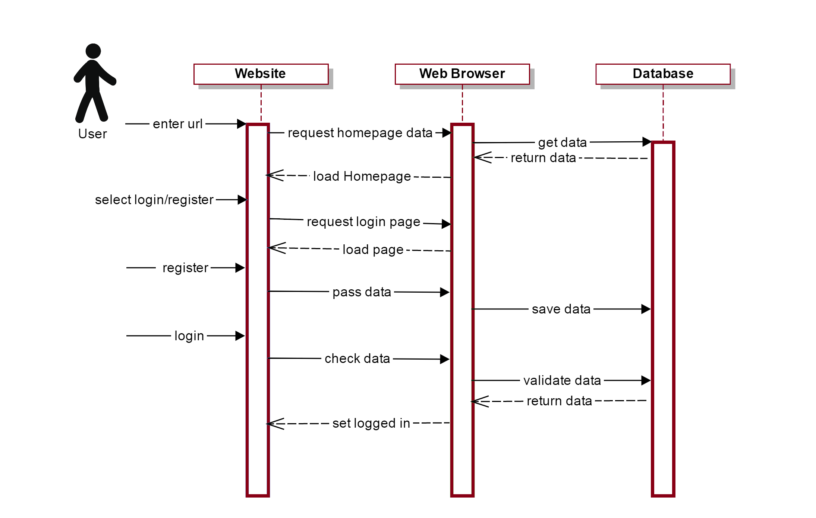
State Transition Diagram

Slide 8
Functional Model and Descriptions
Record and store employee tool data
Record and store truck data
Retrieve data from outside database
Track employee performance metrics
Provide visual representation for data
Display information using a webpage
Login system with hierarchy
Provide different user views depending on login credentials
Admin adjusts the weight of the employee metrics fields
Display leaderboard
User is able to view their own profile
Allow user to test different scores

Slide 9
Behavioral Model and Description
Database should not exceed AWS storage capacity
User interface should refresh in a timely manner
Database should retrieve information from companies twice a day
The leaderboards should show all users that is within the company in a timely manner.
The admin is able to change the weights of the data field through a percentage

Slide 10
Hardware, Software, and Inverse requirements
Hardware
N.A.
Inverse
Interface is not going to calculate employee scores
Software
AWS Software
.Net Framework
HTML
JavaScript
C#
AnglerJS

Slide 11
Validation
Our main method of testing is black-box testing. Some of the categories of testing we will be doing are as follow:
Database Access
Integration
User Acceptance
Login Views
Interface

Slide 12
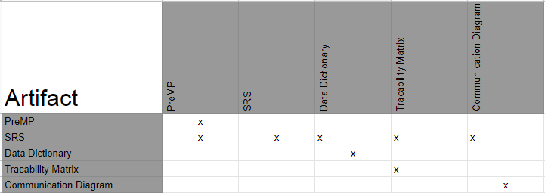
System Traceability Matrix

Slide 13
Analysis Metrics to be Used
LOC
Function Points
Hours

Slide 14
Development Phases
Requirements & Specifications
Storyboard
Back-End Integration
Implementation
Working Prototype
Client Sign-off

Slide 15
Deliverables
Project Outline
Group Member Availability Chart
Weekly Status Report
Bi-weekly Phone Conference
Time Sheets
Localized Prototype
Full Prototype
End Product

Slide 16
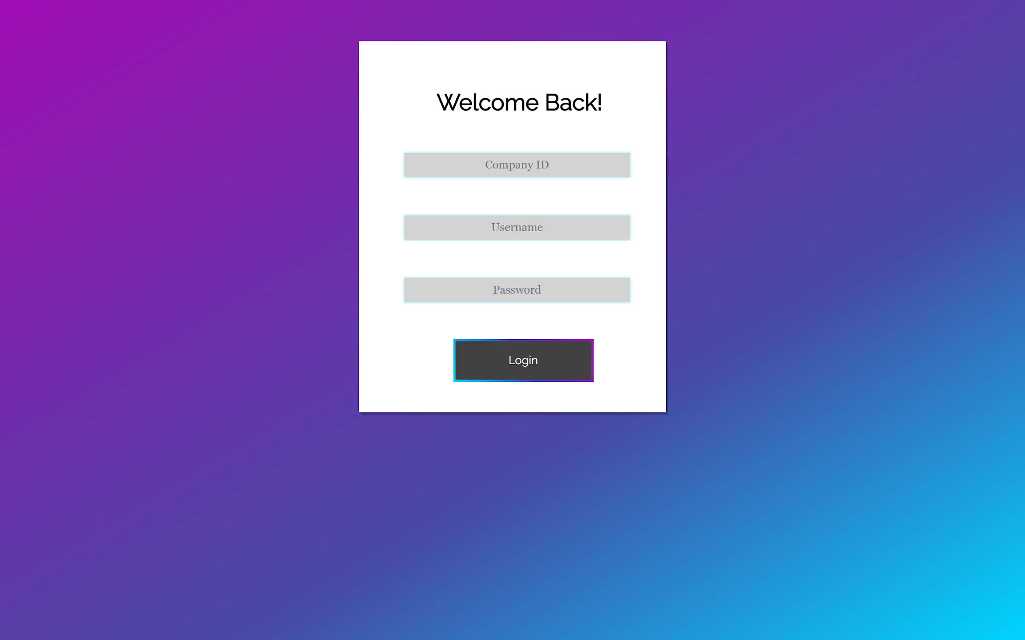
Example Screen - Login

Slide 17
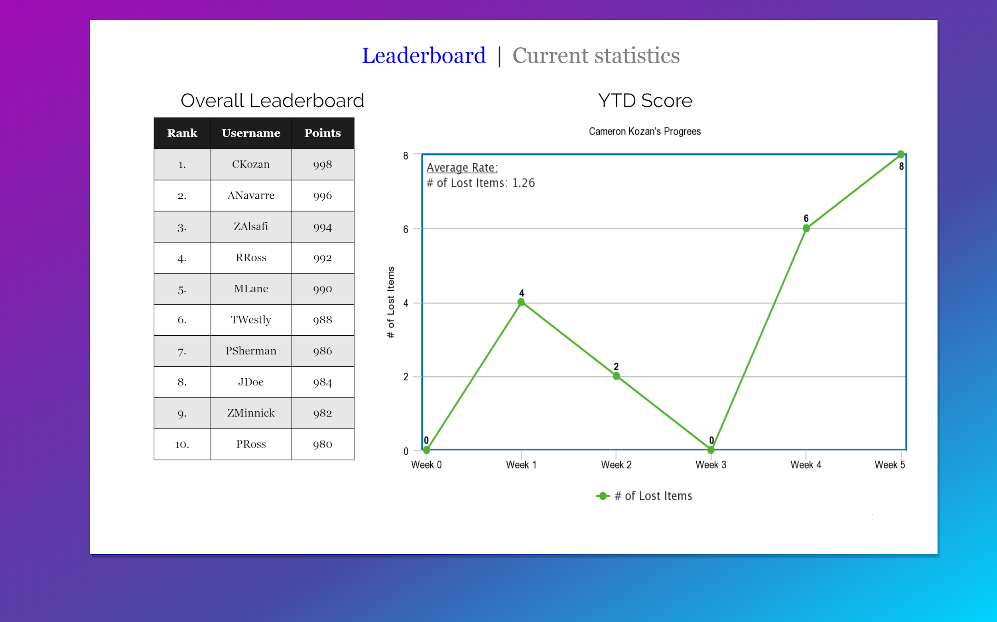
Example Screen - User dashboard

Slide 18
END

